Slide 1


Welcome you all
JAVA PROGRAMMING
DAY : 7
D.Sakthivel
Assistant Professor & Trainer,
KGiSL Micro College
KGiSL Campus, Coimbatore – 641 035.

Slide 2
Day 7
Exception Handling
Exceptions Overview
Catching Exceptions
The finally Block
Exception Methods
Defining and Throwing Exceptions
Errors and Runtime Exceptions

Slide 3
Exception Handling:
Exception handling is the process of handling the errors and nonconforming states, while the program is executed.
Mechanism to handle the runtime errors so that the normal flow of the application can be maintained.
What is Exception in Java?
Dictionary Meaning: Exception is an abnormal condition.
In Java, an exception is an event that disrupts the normal flow of the program.
It is an object which is thrown at runtime.

Slide 4
What is Exception Handling?
Exception Handling is a mechanism to handle runtime errors such as ClassNotFoundException, IOException, SQLException, RemoteException, etc.
Advantage of Exception Handling
The core advantage of exception handling is to maintain the normal flow of the application.
An exception normally disrupts the normal flow of the application; that is why we need to handle exceptions.

Slide 5
Let's consider a scenario:
statement 1;
statement 2;
statement 3;
statement 4;
statement 5;//exception occurs
statement 6;
statement 7;
statement 8;
statement 9;
statement 10;
Suppose there are 10 statements in a Java program and an exception occurs at statement 5; the rest of the code will not be executed, i.e., statements 6 to 10 will not be executed. However, when we perform exception handling, the rest of the statements will be executed. That is why we use exception handling in Java.

Slide 6
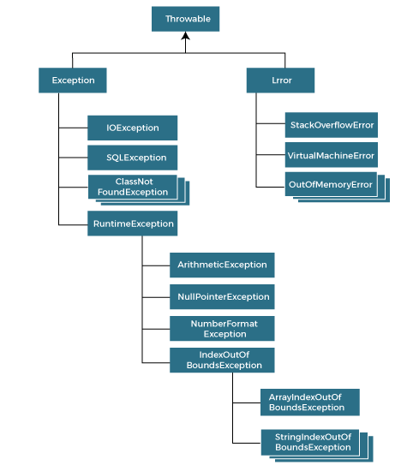
Hierarchy of Java Exception classes
The java.lang.Throwable class is the root class of Java Exception hierarchy inherited by two subclasses: Exception and Error. The hierarchy of Java Exception classes is given below:

Slide 7
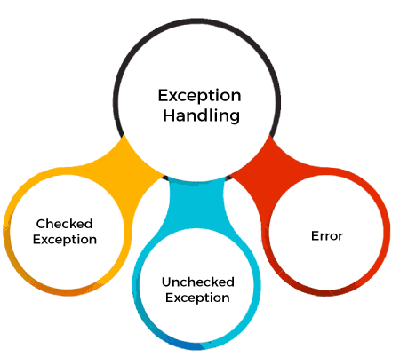
Types of Java Exceptions
There are mainly two types of exceptions: checked and unchecked.
An error is considered as the unchecked exception.
However, according to Oracle, there are three types of exceptions namely:
Checked Exception
Unchecked Exception
Error

Slide 8
Difference between Checked and Unchecked Exceptions
1) Checked Exception
The classes that directly inherit the Throwable class except RuntimeException and Error are known as checked exceptions.
For example, IOException, SQLException, etc. Checked exceptions are checked at compile-time.
2) Unchecked Exception
The classes that inherit the RuntimeException are known as unchecked exceptions.
For example, ArithmeticException, NullPointerException, ArrayIndexOutOfBoundsException, etc. Unchecked exceptions are not checked at compile-time, but they are checked at runtime.
3) Error
Error is irrecoverable. Some example of errors are OutOfMemoryError, VirtualMachineError, AssertionError etc.

Slide 9
Java Exception Keywords
Keyword | Description
try | The "try" keyword is used to specify a block where we should place an exception code. It means we can't use try block alone. The try block must be followed by either catch or finally.
catch | The "catch" block is used to handle the exception. It must be preceded by try block which means we can't use catch block alone. It can be followed by finally block later.
finally | The "finally" block is used to execute the necessary code of the program. It is executed whether an exception is handled or not.
throw | The "throw" keyword is used to throw an exception.
throws | The "throws" keyword is used to declare exceptions. It specifies that there may occur an exception in the method. It doesn't throw an exception. It is always used with method signature.

Slide 10
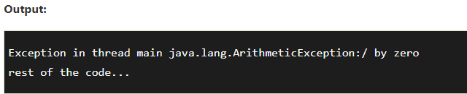
Java Exception Handling Example
public class JavaExceptionExample{
public static void main(String args[])
{
try{
//code that may raise exception
int data=100/0;
}
catch(ArithmeticException e)
{
System.out.println(e);
}
//rest code of the program
System.out.println("rest of the code...");
}
}

Slide 11
Common Scenarios of Java Exceptions
There are given some scenarios where unchecked exceptions may occur. They are as follows:
1) A scenario where ArithmeticException occurs
If we divide any number by zero, there occurs an ArithmeticException.
int a=50/0;//ArithmeticException
2) A scenario where NullPointerException occurs
If we have a null value in any variable, performing any operation on the variable throws a NullPointerException.
String s=null;
System.out.println(s.length());//NullPointerException

Slide 12
3) A scenario where NumberFormatException occurs
If the formatting of any variable or number is mismatched, it may result into NumberFormatException.
Suppose we have a string variable that has characters; converting this variable into digit will cause NumberFormatException.
String s="abc";
int i=Integer.parseInt(s);//NumberFormatException
4) A scenario where ArrayIndexOutOfBoundsException occurs
When an array exceeds to it's size, the ArrayIndexOutOfBoundsException occurs.
there may be other reasons to occur ArrayIndexOutOfBoundsException. Consider the following statements.
int a[]=new int[5];
a[10]=50; //ArrayIndexOutOfBoundsException

Slide 13
Java try-catch block
Java try block
Java try block is used to enclose the code that might throw an exception.
It must be used within the method.
If an exception occurs at the particular statement in the try block, the rest of the block code will not execute.
So, it is recommended not to keep the code in try block that will not throw an exception.
Java try block must be followed by either catch or finally block.
Syntax of Java try-catch
try{
//code that may throw an exception
}catch(Exception_class_Name ref){}
Syntax of try-finally block
try{
//code that may throw an exception
}finally{}

Slide 14
Java catch block
Java catch block is used to handle the Exception by declaring the type of exception within the parameter.
The declared exception must be the parent class exception ( i.e., Exception) or the generated exception type.
However, the good approach is to declare the generated type of exception.
The catch block must be used after the try block only.
You can use multiple catch block with a single try block.

Slide 15
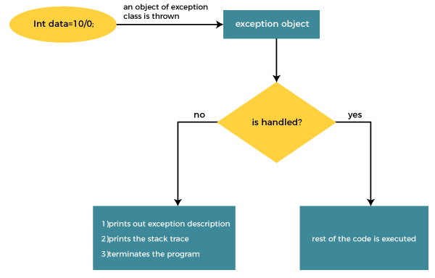

Slide 16
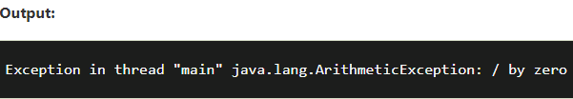
public class TryCatchExample1 {
public static void main(String[] args) {
int data=50/0; //may throw exception
System.out.println("rest of the code");
}
}

Slide 17
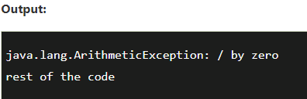
Solution by exception handling
public class TryCatchExample2 {
public static void main(String[] args) {
try
{
int data=50/0; //may throw exception
}
//handling the exception
catch(ArithmeticException e)
{
System.out.println(e);
}
System.out.println("rest of the code");
}
}

Slide 18
Java Multi-catch block
A try block can be followed by one or more catch blocks.
Each catch block must contain a different exception handler.
So, if you have to perform different tasks at the occurrence of different exceptions, use java multi-catch block.
Points to remember
At a time only one exception occurs and at a time only one catch block is executed.
All catch blocks must be ordered from most specific to most general, i.e. catch for ArithmeticException must come before catch for Exception.

Slide 19
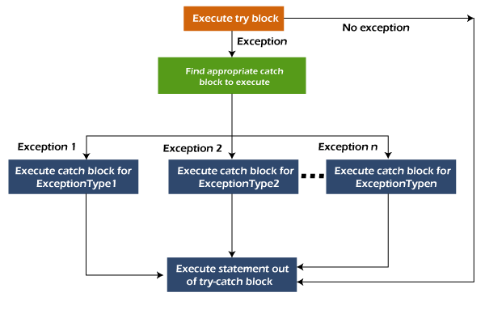
Java Multi-catch block

Slide 20
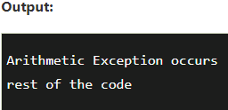
Java Multi-catch block
public class MultipleCatchBlock1 {
public static void main(String[] args) {
try{
int a[]=new int[5];
a[5]=30/0;
}
catch(ArithmeticException e)
{
System.out.println("Arithmetic Exception occurs");
}
catch(ArrayIndexOutOfBoundsException e)
{
System.out.println("ArrayIndexOutOfBounds Exception occurs");
}
catch(Exception e)
{
System.out.println("Parent Exception occurs");
}
System.out.println("rest of the code");
}
}

Slide 21
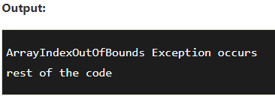
Java Multi-catch block
public class MultipleCatchBlock2 {
public static void main(String[] args) {
try{
int a[]=new int[5];
System.out.println(a[10]);
}
catch(ArithmeticException e)
{
System.out.println("Arithmetic Exception occurs");
}
catch(ArrayIndexOutOfBoundsException e)
{
System.out.println("ArrayIndexOutOfBounds Exception occurs");
}
catch(Exception e)
{
System.out.println("Parent Exception occurs");
}
System.out.println("rest of the code");
}
}

Slide 22
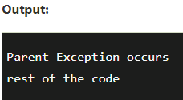
Java Multi-catch block
public class MultipleCatchBlock4 {
public static void main(String[] args) {
try{
String s=null;
System.out.println(s.length());
}
catch(ArithmeticException e)
{
System.out.println("Arithmetic Exception occurs");
}
catch(ArrayIndexOutOfBoundsException e)
{
System.out.println("ArrayIndexOutOfBounds Exception occurs");
}
catch(Exception e)
{
System.out.println("Parent Exception occurs");
}
System.out.println("rest of the code");
}
}

Slide 23
Java Nested try block
In Java, using a try block inside another try block is permitted.
It is called as nested try block.
Every statement that we enter a statement in try block, context of that exception is pushed onto the stack.
For example, the inner try block can be used to handle ArrayIndexOutOfBoundsException while the outer try block can handle the ArithemeticException (division by zero).

Slide 24
Syntax:
//main try block
try
{
statement 1;
statement 2;
//try catch block within another try block
try
{
statement 3;
statement 4;
//try catch block within nested try block
try
{
statement 5;
statement 6;
}
catch(Exception e2)
{
//exception message
}
}
catch(Exception e1)
{
//exception message
}
}
//catch block of parent (outer) try block
catch(Exception e3)
{
//exception message
}
Java Nested try block

Slide 25
Java Nested try block
public class NestedTryBlock
{
public static void main(String args[])
{
//outer try block
try
{
//inner try block 1
try
{
System.out.println("going to divide by 0");
int b =39/0;
}
//catch block of inner try block 1
catch(ArithmeticException e)
{
System.out.println(e);
}

Slide 26
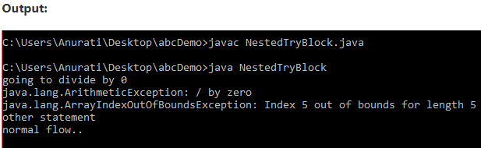
Java Nested try block
//inner try block 2
try{
int a[]=new int[5];
//assigning the value out of array bounds
a[5]=4;
}
//catch block of inner try block 2
catch(ArrayIndexOutOfBoundsException e)
{
System.out.println(e);
}
System.out.println("other statement");
}
//catch block of outer try block
catch(Exception e)
{
System.out.println("handled the exception (outer catch)");
}
System.out.println("normal flow..");
}
}

Slide 27
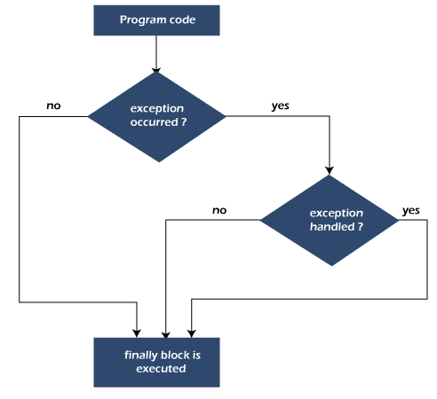
Java finally block
Java finally block is a block used to execute important code such as closing the connection, etc.
Java finally block is always executed whether an exception is handled or not. Therefore, it contains all the necessary statements that need to be printed regardless of the exception occurs or not.
The finally block follows the try-catch block.

Slide 28
Why use Java finally block?
finally block in Java can be used to put "cleanup" code such as closing a file, closing connection, etc.
The important statements to be printed can be placed in the finally block.

Slide 29
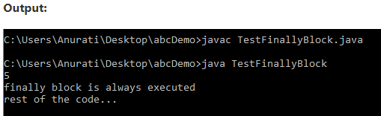
class TestFinallyBlock {
public static void main(String args[]){
try{
//below code do not throw any exception
int data=25/5;
System.out.println(data);
}
//catch won't be executed
catch(NullPointerException e){
System.out.println(e);
}
//executed regardless of exception occurred or not
finally {
System.out.println("finally block is always executed");
}
System.out.println("rest of phe code...");
}
}

Slide 30
Java throw Exception
In Java, exceptions allows us to write good quality codes where the errors are checked at the compile time instead of runtime and we can create custom exceptions making the code recovery and debugging easier.
Java throw keyword
The Java throw keyword is used to throw an exception explicitly.
We specify the exception object which is to be thrown.
The Exception has some message with it that provides the error description.
These exceptions may be related to user inputs, server, etc.
We can throw either checked or unchecked exceptions in Java by throw keyword. It is mainly used to throw a custom exception. We will discuss custom exceptions later in this section.
We can also define our own set of conditions and throw an exception explicitly using throw keyword. For example, we can throw ArithmeticException if we divide a number by another number.
Here, we just need to set the condition and throw exception using throw keyword.

Slide 31
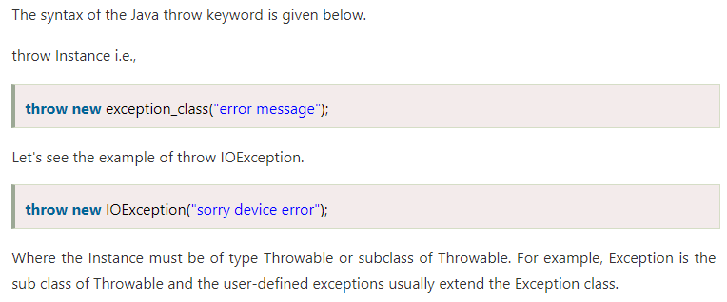
Java throw Exception

Slide 32
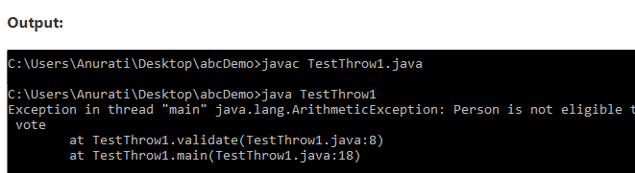
Java throw keyword
public class TestThrow1 {
//function to check if person is eligible to vote or not
public static void validate(int age) {
if(age<18) {
//throw Arithmetic exception if not eligible to vote
throw new ArithmeticException("Person is not eligible to vote");
}
else {
System.out.println("Person is eligible to vote!!");
}
}
//main method
public static void main(String args[]){
//calling the function
validate(13);
System.out.println("rest of the code...");
}
}

Slide 33
Throwing User-defined Exception
import java.util.*;
class InvalidAgeException extends Exception
{
// Declare a parameterized exception with string str as a parameter.
InvalidAgeException(String str)
{
super(str);
}
}
public class TestClass
{
private static int age;
static void validate() throws InvalidAgeException
{
Scanner sc = new Scanner(System.in);
System.out.println("Enter your age");
age = sc.nextInt();

Slide 34
if(age < 18)
{
throw new InvalidAgeException("Invalid Age, You are not eligible to vote");
}
else
{
System.out.println("Welcome to vote");
}
}
public static void main(String[] args)
{
try
{
validate();
}
catch(Exception e)
{
System.out.println("Caught an Exception: \n "+e);
}
}
}

Slide 35
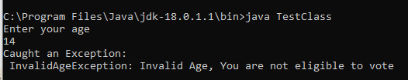
OUTPUT:

Slide 36
Java throws keyword
The Java throws keyword is used to declare an exception. It gives an information to the programmer that there may occur an exception.
So, it is better for the programmer to provide the exception handling code so that the normal flow of the program can be maintained.
Exception Handling is mainly used to handle the checked exceptions.
If there occurs any unchecked exception such as NullPointerException, it is programmers' fault that he is not checking the code before it being used.
Syntax of Java throws
return_type method_name() throws exception_class_name
{
//method code
}

Slide 37
Java throws keyword
Advantage of Java throws keyword
Now Checked Exception can be propagated (forwarded in call stack).
It provides information to the caller of the method about the exception.
There are two cases:
Case 1: We have caught the exception i.e. we have handled the exception using try/catch block.
Case 2: We have declared the exception i.e. specified throws keyword with the method.

Slide 38
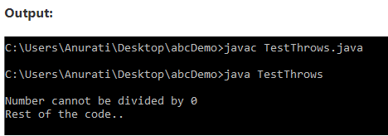
Java throws Example
public class TestThrows {
//defining a method
public static int divideNum(int m, int n) throws ArithmeticException {
int div = m / n;
return div;
}
//main method
public static void main(String[] args) {
TestThrows obj = new TestThrows();
try {
System.out.println(obj.divideNum(45, 0));
}
catch (ArithmeticException e){
System.out.println("\nNumber cannot be divided by 0");
}
System.out.println("Rest of the code..");
}
}

Slide 39
Difference between throw and throws in Java
Sr. no. | Basis of Differences | throw | throws
1. | Definition | Java throw keyword is used throw an exception explicitly in the code, inside the function or the block of code. | Java throws keyword is used in the method signature to declare an exception which might be thrown by the function while the execution of the code.
2. | Type of exception Using throw keyword, we can only propagate unchecked exception i.e., the checked exception cannot be propagated using throw only. | Using throws keyword, we can declare both checked and unchecked exceptions. However, the throws keyword can be used to propagate checked exceptions only.

Slide 40
Difference between throw and throws in Java
Sr. no. | Basis of Differences | throw | throws
3. | Syntax | The throw keyword is followed by an instance of Exception to be thrown. | The throws keyword is followed by class names of Exceptions to be thrown.
4. | Declaration | throw is used within the method. | throws is used with the method signature.
5. | Internal implementation | We are allowed to throw only one exception at a time i.e. we cannot throw multiple exceptions. | We can declare multiple exceptions using throws keyword that can be thrown by the method. For example, main() throws IOException, SQLException.

Slide 41
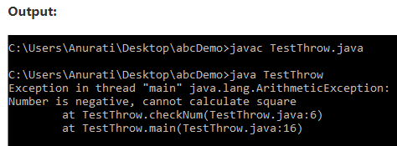
Java throw Example
public class TestThrow {
//defining a method
public static void checkNum(int num) {
if (num < 1) {
throw new ArithmeticException("\nNumber is negative, cannot calculate square");
}
else {
System.out.println("Square of " + num + " is " + (num*num));
}
}
//main method
public static void main(String[] args) {
TestThrow obj = new TestThrow();
obj.checkNum(-3);
System.out.println("Rest of the code..");
}
}

Slide 42
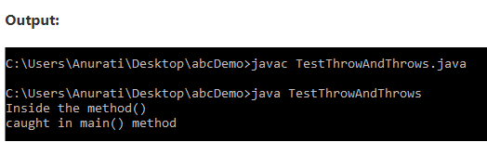
Java throw and throws Example
public class TestThrowAndThrows
{
// defining a user-defined method
// which throws ArithmeticException
static void method() throws ArithmeticException
{
System.out.println("Inside the method()");
throw new ArithmeticException("throwing ArithmeticException");
}
//main method
public static void main(String args[])
{
try
{
method();
}
catch(ArithmeticException e)
{
System.out.println("caught in main() method");
}
}
}

Slide 43
Why use custom exceptions?
Java exceptions cover almost all the general type of exceptions that may occur in the programming. However, we sometimes need to create custom exceptions.
Following are few of the reasons to use custom exceptions:
To catch and provide specific treatment to a subset of existing Java exceptions.
Business logic exceptions: These are the exceptions related to business logic and workflow.
It is useful for the application users or the developers to understand the exact problem.
In order to create custom exception, we need to extend Exception class that belongs to java.lang package.

Slide 44
Java Custom Exception
In Java, we can create our own exceptions that are derived classes of the Exception class.
Creating our own Exception is known as custom exception or user-defined exception.
Basically, Java custom exceptions are used to customize the exception according to user need.
Consider the example 1 in which InvalidAgeException class extends the Exception class.
Using the custom exception, we can have your own exception and message.
Here, we have passed a string to the constructor of superclass i.e. Exception class that can be obtained using getMessage() method on the object we have created.

Slide 45
Consider the following example, where we create a custom exception named WrongFileNameException:
public class WrongFileNameException extends Exception {
public WrongFileNameException(String errorMessage) {
super(errorMessage);
}
}

Slide 46
/ class representing custom exception
class InvalidAgeException extends Exception
{
public InvalidAgeException (String str)
{
// calling the constructor of parent Exception
super(str);
}
}
// class that uses custom exception InvalidAgeException
public class TestCustomException1
{
// method to check the age

Slide 47
/static void validate (int age) throws InvalidAgeException{
if(age < 18){
// throw an object of user defined exception
throw new InvalidAgeException("age is not valid to vote");
}
else {
System.out.println("welcome to vote");
}
}
// main method
public static void main(String args[])
{
try
{
// calling the method
validate(13);
}

Slide 48
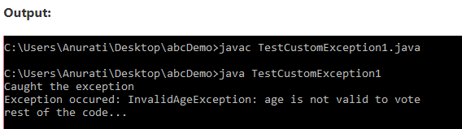
catch (InvalidAgeException ex)
{
System.out.println("Caught the exception");
// printing the message from InvalidAgeException object
System.out.println("Exception occured: " + ex);
}
System.out.println("rest of the code...");
}
}

Slide 49



Thank You

